Slide 1

Canterbury Tales
Background Introduction

Slide 2
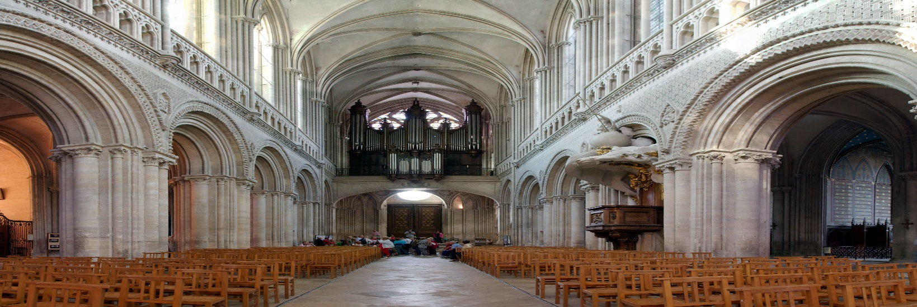
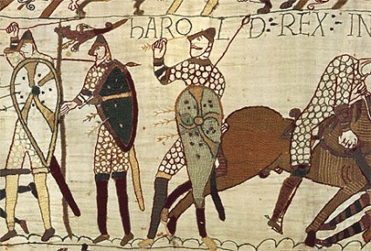
The Journey Begins . . .
In October 1066, a daylong battle near Hastings, England, changed the course of history.
Battle of Hastings Reenactment

Slide 3
England in the Middle Ages
Feudalism replaced the Nordic social system.
  The primary duty of males above the serf class was to serve in the military—Knighthood.
  Women had no political rights.
  Chivalry and courtly love served as the system of social codes

Slide 4
England in the Middle Ages
Lower, middle, and upper-middle classes developed in the cities.

Slide 5
England in the Middle Ages
The Crusades extended from 1095-1270.
  7-8 Crusades: Religious pilgrimages with a side of war to free Christians from the Jihad
  They brought contact with Eastern mathematics, astronomy, architecture, and crafts.
Crusades Report
Crusades vs. Jihad

Slide 6
England in the Middle Ages
The Hundred Years’ War (1337-1453) was the first national war waged by England.
Who is Joan of Arc?
100 Years War in 3 Minutes

Slide 7
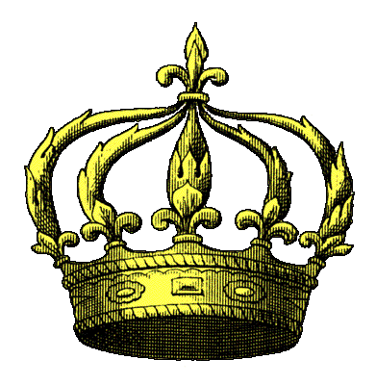
England in the Middle Ages
The Magna-Carta halted the King’s abuse of power.
Magna Carta Timeline
What is Magna Carta?
Magna Carta contained 63 promises about what the king could and couldn't do. It also set up a Council of 25 barons to make sure John kept his promises. This was a direct attack on John's royal authority, and as soon as he could, John asked the Pope for permission to ignore Magna Carta – on the grounds that he had been forced to sign it. John's rejection of Magna Carta caused another rebellion by the barons. In 1305 the Pope annulled Magna Carta. Within 50 years, England had a Parliament to represent the barons’ wishes to the king.

Slide 8
England in the Middle Ages
The Black Death (1348-1349) brought the end of the Middle Ages.
Fleas on rats
carried the bubonic
plague which killed
thousands of people
in Europe.
Black Death

Slide 9
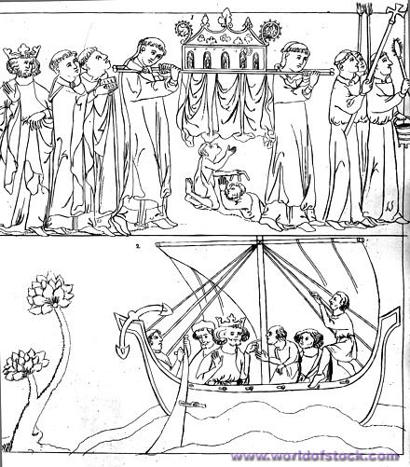
Background of these tales
Geoffrey Chaucer
wrote this story in
the late 1300’s but
never finished it.
He wrote in the
native language or
vernacular of the
Medieval Period in
Britain called Middle
English.

Slide 10
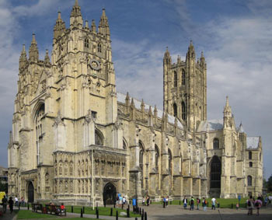
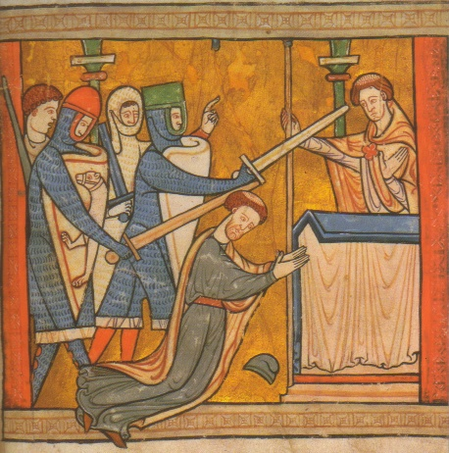
The Destination…
The cathedral at Canterbury is the main cathedral of the Church of England. The shrine to the martyr Saint Thomas á Becket is located at this cathedral.

Slide 11
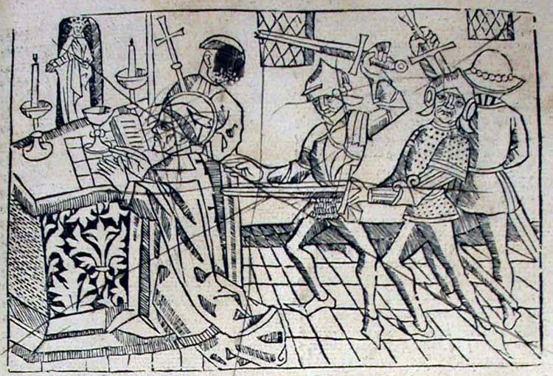
Their Reason….
Saint Thomas á Becket was the archbishop of Canterbury, and in 1170 he was martyred by some knights of the king of England, Henry II, who was overheard complaining about Becket’s loyalty to the church at Rome over his loyalty to his king.

Slide 12
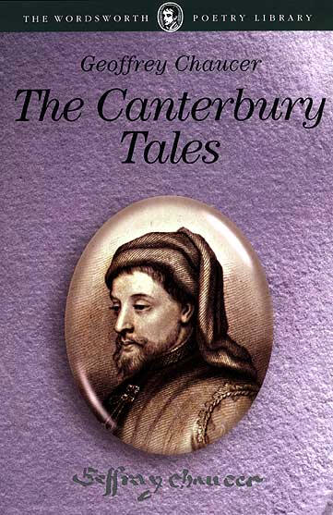
The Journey Begins . . .
Chaucer uses a religious pilgrimage to display all segments of medieval England.
The Canterbury Tales begins with a Prologue,
  Narrator, presumably Chaucer himself, meets 29 other pilgrims at the Tabard Inn, located in a suburb of London.
As the pilgrims prepare for their journey, the host of the Inn, Harry Bailey, sets a challenge:
  Each pilgrim tell two stories on the way to Canterbury and two stories on the return trip. The person who tells the best tale will be treated to a feast hosted by the other pilgrims.

Slide 13
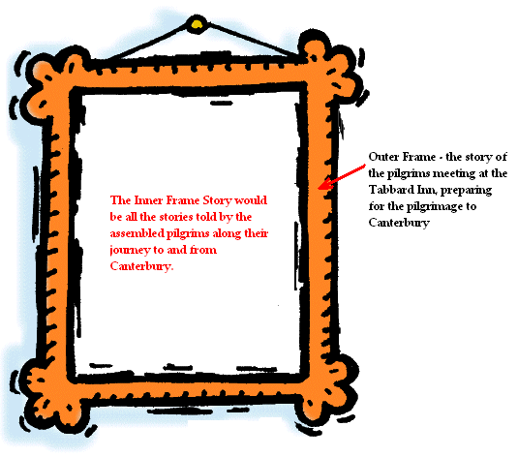
The Journey Begins . . .
The Canterbury Tales is actually a story about stories, twenty-four different tales set within the overarching tale of the pilgrimage.
Definition:
  Frame Story – a story within a story
    The Outer Frame Story is about the pilgrims meeting at the Tabard Inn preparing for a journey to Canterbury.
    The Inner Frame Story would be all the stories told by the assembled pilgrims along their journey to and from Canterbury.

Slide 14
The Travelers to Canterbury
Working Class
Plowman
Haberdasher
Cook
Dyer
Miller
Carpenter
Reeve
Weaver
Host
Carpetmaker

Slide 15
The Travelers to Canterbury
Professional Class
Military
Knight, Squire, Yeoman
Religious
Nun, 3 Priests, Friar, Parson,
Pardoner, Summoner
Secular
Cleric, Serjeant at Law, Merchant,
Skipper, Doctor

Slide 16
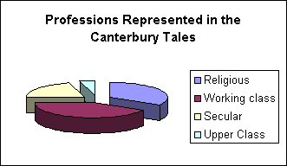
The Travelers to Canterbury
Upper Class
Wife of Bath
Franklin

Slide 17
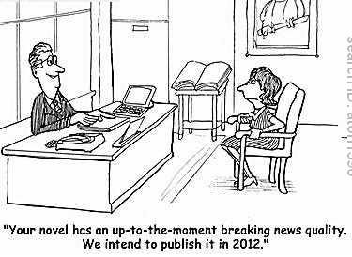
Snapshots of an Era. . .
In the Prologue, Chaucer sketches a brief but vivid portrait of each pilgrim, creating a lively sense of medieval life.
The description may literally describe an article of clothing, but figuratively imply something about that character.
Definition: Satire - a literary composition, in verse or prose, in which human folly and vice are held up to scorn, derision, or ridicule.
  Like sarcasm . . . He says one thing, but means another.
  Our job is to read and comprehend the literal description of each pilgrim, and then, we must figuratively interpret what Chaucer is trying to imply about that pilgrim’s character.

Slide 18

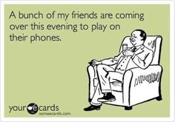
Snapshots of an Era. . .
Two types of Satire:
  1. Juvenalian - After the Roman satirist Juvenal: Formal satire in which the speaker attacks vice and error with contempt and indignation Juvenalian satire in its realism and its harshness is in strong contrast to Horatian satire.
  {Serious – Critical}
  2. Horatian - After the Roman satirist Horace: Satire in which the voice is indulgent, tolerant, amused, and witty. The speaker holds up to gentle ridicule the absurdities and follies of human beings, aiming at producing in the reader not the anger of a Juvenal, but a wry smile.
  {Light – Funny}

Slide 19

Snapshots of an Era. . .
Satire (continued . . . ):
  Also, so that we might better understand his satirical characterization, Chaucer creates SATIRIC NORMS.
  A SATIRIC NORM is a character that represents the perfect ideal.
  We can then see how BAD everyone else is by comparing them to this Satiric Norm.

Slide 20
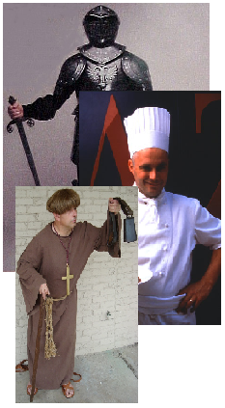
Snapshots of an Era. . .
In the Prologue, Chaucer examines three segments of Medieval England:
  1. The Old Feudal order – these are all of the pilgrims associated with the feudal class system.
    Knight, Squire, Yeoman, Plowman . . .
  2. The Merchant Class – this was the rising middle class of the time; towns and cities were emerging and therefore necessitated the need for skilled services:
    Merchant, Man of Law, Guildsmen, Cook . . .
  3. The Ecclesiastical (Church) Class – these were all of the members of the church. Chaucer is most critical of this segment of his society.
    Prioress, Monk, Friar, Pardoner . . .

Slide 21
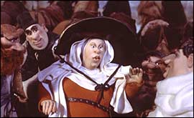
A Literary Tour. . .
Chaucer uses the popular genres of his time when he creates the inner stories of the various pilgrims:
  Romances (tales of chivalry)
    The Wife of Bath’s Tale
  Fabliaux (short, bawdy, humorous stories)
    The Miller’s Tale
  The stories of saint’s lives, sermons
    The Parson’s Tale
  Allegories (narratives in which characters represent abstractions such as Pride or Honor).
    The Pardoner’s Tale
Chaucer wrote much of the Tales using his own form, the heroic couplet, a pair of rhyming lines with five stressed syllables each.

Slide 22
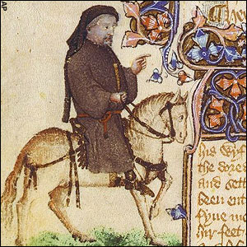
Literary Analysis
Characterization
  Direct characterization presents direct statements about a character, such as Chaucer’s statement that the Knight “followed chivalry, / Truth, honor. . . .”
  Indirect characterization uses actions, thoughts, and dialogue to reveal a character’s personality. By saying “he was not gaily dressed,” for instance, Chaucer suggests that the Knight is not vain and perhaps takes the pilgrimage seriously enough to rush to join it straight from battle.

Slide 23
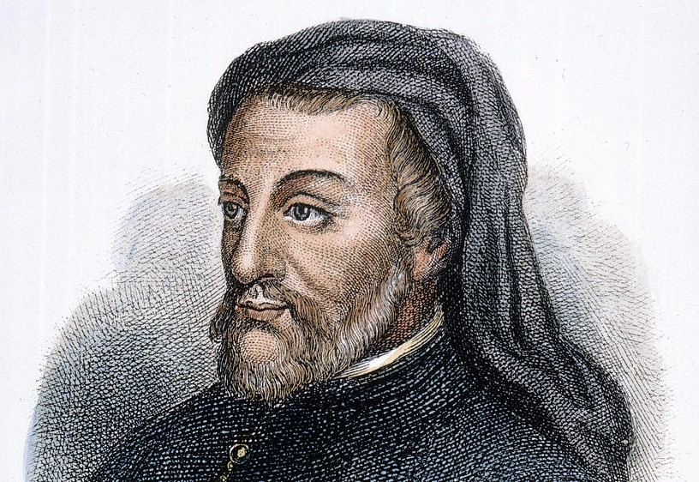
Literary Analysis
Each character in The Canterbury Tales represents a different segment of society in Chaucer’s time. By noting the virtues and faults of each, Chaucer provides social commentary, writing that offers insight into society, its values, and its customs. While reading, draw conclusions from the characters about Chaucer’s views on English society.

Slide 24
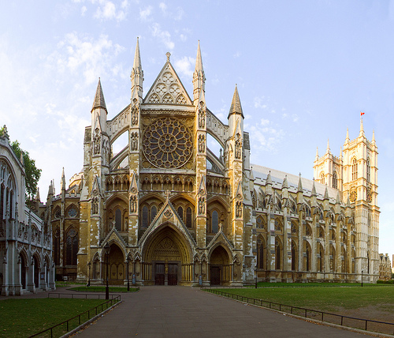
Geoffrey Chaucer c. 1343-1400
Considered the father of English poetry
Wrote in the vernacular – common language of the people (English)
Served as a soldier, government servant, and member of Parliament
Introduced iambic pentameter
First writer buried in Westminster Abbey

