Slide 1
All about satire
All you never knew
you ever wanted to know

Slide 2
Horatian

Slide 3
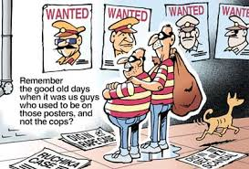
Juvenalian
Think “juvenile” as in….it’s juvenile to be rude. If you’re VERY rude and obnoxious….you will go to juvie.

Slide 4
Menippean

Slide 5
Exaggeration or overstatement
Languages of the World

Slide 6
Understatement

Slide 7
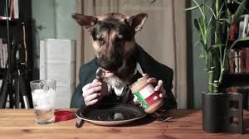
Incongruity

Slide 8
Deflation
Miss South Carolina…such as…

Slide 9
Linguistic games/malapropism
Having one wife is called “monotony.”
Don’t cross your bridges before they hatch.
Lepers don’t change their spots.
Security is laxative around here.
Socrates was killed by an overdose of wedlock.
Sir Francis Drake circumcised the globe with a 100 foot clipper.

Slide 10
Surprise!
Many jokes end with a surprise twist.
Examples….
A Baptist who moved into a Catholic neighborhood
2 big game hunters after grizzlies in Yellowstone Park
Knock knock! Who’s there? Ya. Ya Who? Yahoo.com
Mannequin Head…or Not?
A Bathroom or a Business Meeting?

Slide 11
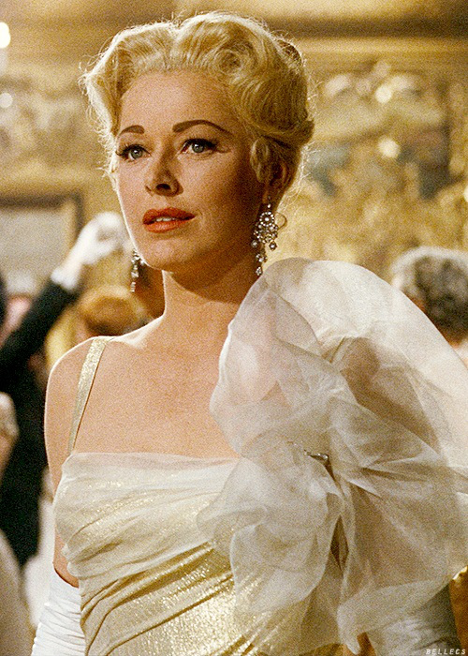
Irony
From The Sound of Music:
Elsa: My dear, is there anything you can't do?
Maria: Well, I'm not sure I'll make a very good nun.
Elsa: Oh, if you have any problems, I'd be happy to help you.
Oh, the Irony!!!

Slide 12
Verbal irony
It’s as clear as mud.
I’m as relaxed as a coiled rattlesnake.

Slide 13
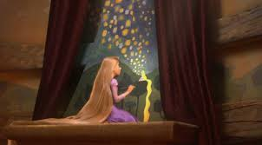
Dramatic irony
In the movie Tangled, the audience knows that Rapunzel is the princess and the lanterns are for her. Rapunzel, however, is unaware, thus leading to her adventure away from the tower.

Slide 14
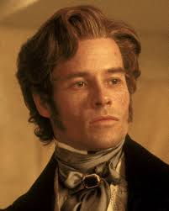
Socratic irony
What happens between parents and kids…..
P: “I wonder how that chocolate smeared itself all over your mouth.”
K: “The cookie monster did it.”
In the movie version of the Count of Monte Cristo, Fernand (aka Mr. Steal Your Girl) pretends not to know that Dante is innocent. He does this for his own gain, but in the end, he pays for his betrayal.
The Socratic Method

Slide 15
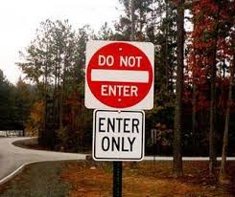
Situational irony
The Ransom of Red Chief by O’ Henry….
It’s not every kidnapper who has to pay
the family to take the child back. Ransom of Red Chief Trailer
In Shrek, the situational irony is that the “monster” is good while
Prince Charming and the Fairy godmother are evil.

Slide 16
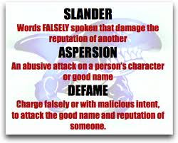
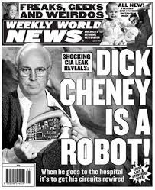
Invective
Toystory Invectives
Stereotypes as Invectives

Slide 17
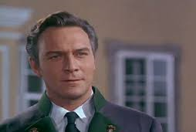
Mock encomium
Writing in someone’s yearbook: “You are unforgettable.”
Sound of Music:
Baron: Is there a more beautiful expression of what is good in this
country of ours than the innocent voices of our children?
Zeller: Oh, come now, Baron, would you have us believe that Austria alone holds a monopoly on virtue?
Captain: Herr Zeller, some of us prefer Austrian voices raised in song to ugly German threats.
Zeller: The ostrich buries his head in the sand, and sometimes in the flag. [He turns toward the Austrian flag, prominently displayed] Perhaps those who would warn you that the Anschluss is coming - and it is coming, Captain - perhaps they would get further with you by setting their words to music.
Captain: If the Nazis take over Austria, I have no doubt, Herr Zeller, that you will be the entire trumpet section.
Zeller: You flatter me, Captain.
Captain: Oh, how clumsy of me. I meant to accuse you.

Slide 18
grotesque
Monty Python: Holy Grail Witch Scene

Slide 19
Comic juxtaposition
My son says his important subjects in school are Calculus, Computer Science, Physics, and girl-watching.

Slide 20
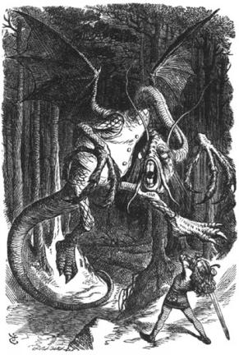
Mock Epic/Mock Heroic
`Twas brillig, and the slithy toves Did gyre and gimble in the wabe: All mimsy were the borogoves, And the mome raths outgrabe.
"Beware the Jabberwock, my son! The jaws that bite, the claws that catch! Beware the Jubjub bird, and shun The frumious Bandersnatch!"

Slide 21
Parody
Melissa: AGT Celebrity Parody

Slide 22
Inflation
Stephen Colbert is a master at this:
Colbert Report: Fast Food Strike

Slide 23
diminution
No one does this better than Jon Stewart!
Boston Massacre Terrorists Rights Discussion

Slide 24
absurdity
Parent Trap: 2 kids who meet and realize they’re twins and then switch places…with all the escapades that follow….could happen, but is carried to absurd lengths.
The Fencing Scene where it all started...
In persuasion, absurdity it is taking an argument to absurd lengths to prove how fallacious it is.
Should Kids have to Learn Math?

Slide 25
Wit/word play
From Ralph Ellison’s Invisible Man:
Trueblood's play on the word whippoorwill: "we'll whip ole Will when we find him.“
In Chapter 25, Dupre, providing instructions for burning down the tenement building, warns, "After that it's every tub on its own black bottom!" Ellison might have used the more common and less colorful phrase, After that it's every man for himself, but this would not have grounded the scene in black culture.

Slide 26
euphemism
“Royal wench! She made great Caesar lay his sword to bed. He plowed her, and she cropped.”
Shakespeare, Antony and Cleopatra, II, ii.
You are becoming a little thin on top (bald).
Our teacher is in the family way (pregnant).
He is always tired and emotional (drunk).

Slide 27
travesty
Henry VIII

Slide 28
burlesque
There are 2 types of burlesque: High and Low.
High Burlesque: inappropriate subject matter is dolled up and treated like it was literary gold. Sort of like Morgan Freeman and other actors reading Fifty Shades of Grey aloud as though it were Shakespeare.
Low Burlesque where a serious or private subject is treated to an irreverent or mocking style….often referred to as “off color” or “inappropriate”. Think SNL!
Women’s Bathroom

Slide 29
farce
The 3 Stooges….a prime example
Someone's roughing up the sisters … rat lips clip

Slide 30
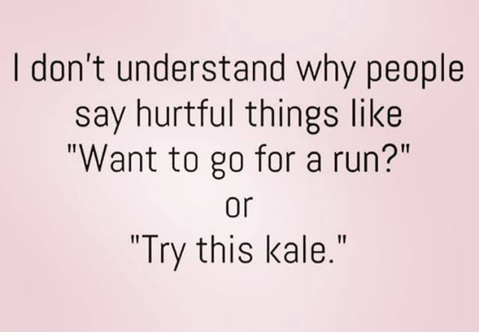
sarcasm
Ellen DeGeneres!
86th Oscar Opening
Or….a sarcasm sign

Slide 31
Knaves & Fools
Robin Hood: Men in Tights 1993 Trailer

Slide 32
Reversal
Dr. Quinn Medicine Woman has many role reversals:
*Micaela uses her mirror to save Sully from snake
*Micaela drags unconscious Sully from the water
*Micaela helps badly injured Sully regain use of his legs
*Micaela saves the Chief
This was all set during the days of the Wild West when men were to be the heroes.
DQMW Season 4 Trailer

Slide 33
Horation or Juvenalian? Scale 1 to 10?

Slide 34
Horation or Juvenalian? Scale 1 to 10?

Slide 35
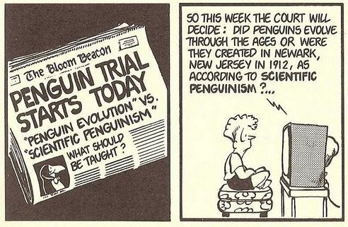
Horation or Juvenalian? Scale 1 to 10?
Garry Trudeau: Doonesbury

